Slide 1

Leadership development programme
How we got here….
WRES* Findings
  Representation peaks at AfC B3&5, little representation in managerial positions
  Minority Ethnic colleagues more likely to experience discrimination and bullying
  Less likely to undertake non mandatory training
Content shaped thorough the lived experience of staff shared via feedback from Cultural Diversity Networks
Elevate is a collaboration across East & Mid Cheshire, Countess of Chester and now Liverpool University Hospitals NHS Trusts
Programme initially ran as the BAME** Leadership Programme in 2022 and reflects positive action to encourage greater levels of diverse leadership in the NHS
Programme (and delegate places) funded c/o Cheshire & Merseyside People Board and Health Education England
Re-branded to Elevate for 2023 the new name reflects the evolving conversation around use of the acronym BAME and reflects the overarching objective to elevate colleagues from minority ethnic communities into leadership positions across the NHS.
A further 48 delegates across 4 Trusts will progress through the programme in 2023
Target audience are colleagues from Black Asian and Minority Ethnic communities at AfC B4, B5 B6 or clinical equivalent
Programme has been enhanced with improved pre/post course evaluation
*Workforce Race Equality Standard **Black Asian Minority Ethnic
Notes:
How do we support BAME employees to claim the career ladder?
2020 has brought about an increased awareness of the inequalities that exist in our society. Many people still face complex barriers to Health, Social Care, Education and Career progression. Barriers to career progression are something that is particularly relevant for BAME (Black, Asian and Minority Ethnic) Staff who, according to vast research by NHS England and NHS Staff Survey feedback, experience multiple difficulties in furthering their careers.
Why is this?
3 Main points:
Lack of opportunities - Research shows that many employees from a BAME background do not have access to the contacts, networks or skill development required. They are less likely to be given opportunities for development within their roles within their ward or offices to help them progress to the next level. Research from Workforce Race Equality Standard (WRES) also indicates that BAME staff are less likely to attend formal CPD training than their White colleagues.
Discrimination (whether through overt or unconscious bias) – means that assumptions can often be made regarding peoples career aspirations, favouritism of white colleagues, and even blatant bullying that undermines self-esteem and confidence.
Absence of BAME role models - A significant lack of BAME role models in senior positions is another factor in limiting the advances of BAME employees. Employees report never seeing a leader who ‘looks like them’.
The existence of a bespoke BAME Leadership course demonstrates a strong commitment to the development of BAME staff, and helps to put the spotlight on managers to encourage BAME staff in their career aspirations.
BAME Progression Ratio - (Likelihood of a White candidate being appointed over a BAME candidate
National WRES Findings
1.61 x more likely*
ECNT
1.24 x more likely
MCHFT
3.57 x more likely
CoC
2.48 x more likely
Equality of career progression - % of BAME staff believing they have equality of career progression with White colleagues
National WRES
71%
ECNT
83%
MCHFT
68%
CoC
68%

Slide 2
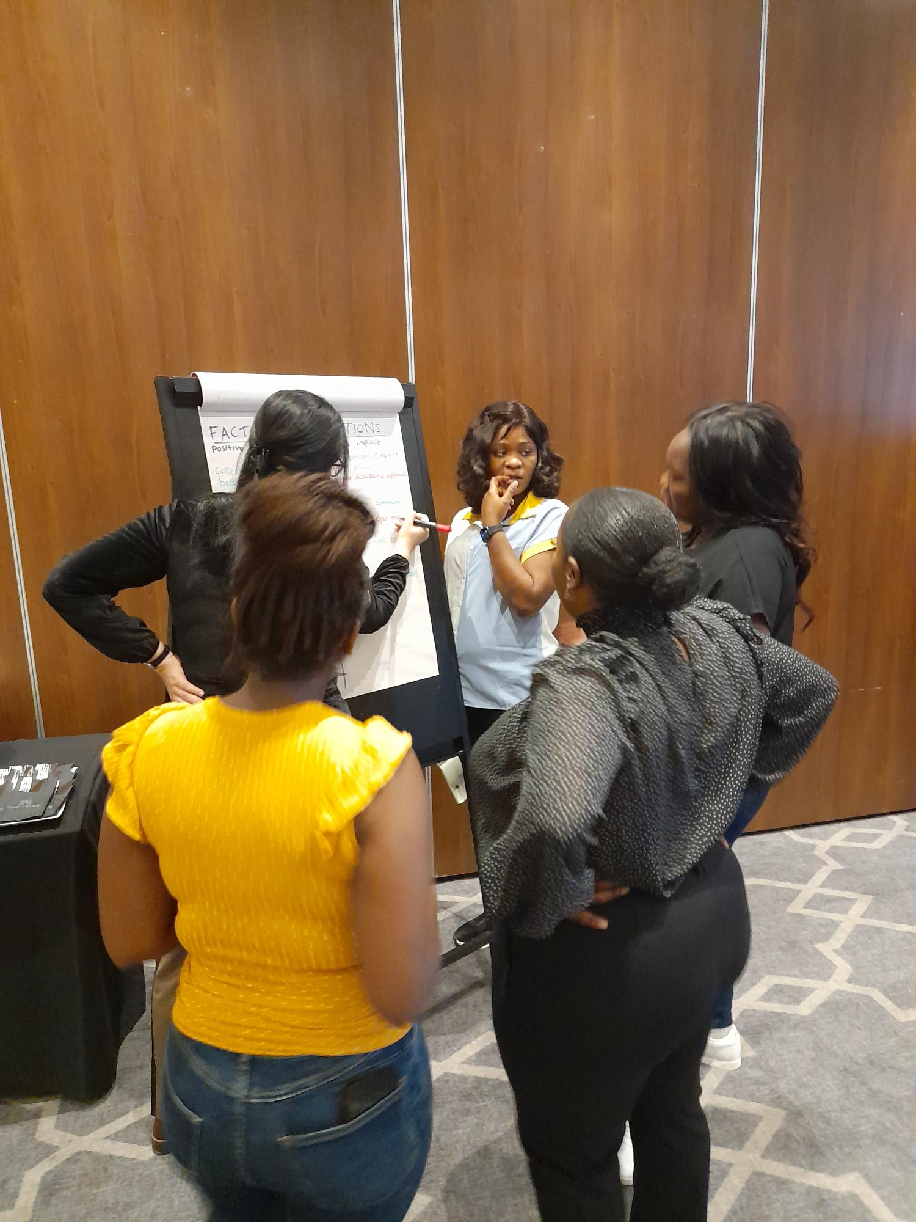
Programme dates
2023
Key dates:
w/c 10th July Trust wide comms commence
Applications open
4th August Application window closed
w/c 10th August Shortlisting
16th August Managers informed if their staff have been awarded a place
Delegates also informed
27th September Programme commences

Slide 3
Leadership Development Programme
Overview of content
Module One
Knowing me, Knowing you
Module Two
Developing your brand
Module Three
What is leadership
Leading in the NHS, recognising and adapting to differing leadership styles in others
Module Four
Module Five
What type of leader are you
Understanding organisational culture
Module Six
The Way ahead
Getting to know delegates, why positive action is needed, understanding barriers to progression
Importance of self-branding, owning your own sub conscious bias, shaking of or living with imposter syndrome
Our leadership way
How organisational culture influences decisions, How to challenge with impact, obtaining allies and sponsors,
Personal aspirations, line manager support, action learning sets, making the shortlist

Slide 4
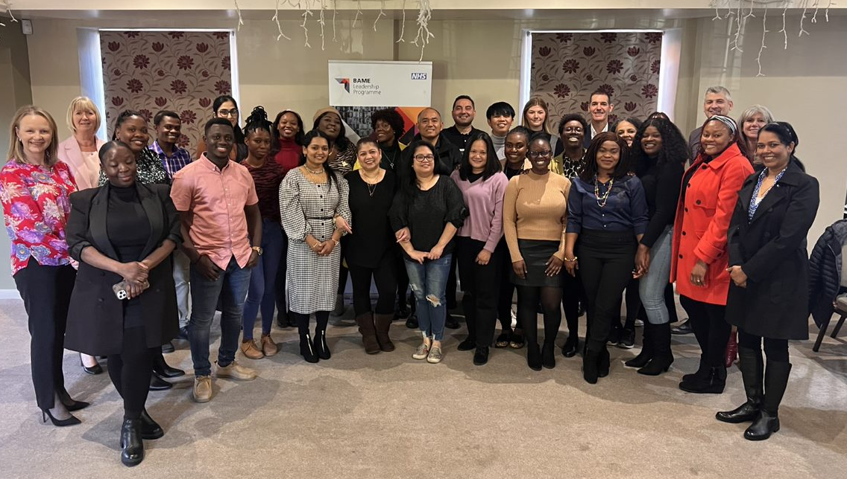

The power of success, of the class of 2022:
21% of delegates have secured a promotion post programme:
1 x Sister now a Senior Sister
3 x Staff Nurse now Sisters
1 x Staff Nurse now Charge nurse
1 x ST4 Trainee Registrar now a ST5
1 x Band 5 fundraiser is now a Band 6 Patient Experience Advisor
9% of delegates have also taken on additional responsibilities
2 x colleagues now leads their Trusts Black Asian and Minority Ethnic staff networks
1 x colleague has expanded their role to include onboarding international doctors as well as Nurses
1 x colleague is studying for a degree funded by their NHS Trust
2 colleagues are now being mentored by senior leaders, 1 x Board Member and 1 x Deputy Finance Director
BAME Leadership
Programme
Class of 2022

